Slide 1
Group meeting: fast brain MRI segmentation by expectation maximization algorithm
胡鎧麟

Slide 2
Problem definition:
the log likelihood for Gaussian Mixture Model(GMM) is difficult to be maximized
We need to use an alternative auxiliary function, which is a lower bound for log likelihood, to achieve the maximization purpose
Apply GMM generative model to clustering task
First, we need to measure the discrete probability distribution for each cluster k
$$P\left(z_{i}=k\right)=w_{k}$$
and
$$Σ_{k}w_{k}=1$$
Then we generate the data point $i$ from specific cluster $k$, which is usually assumed to be the Gaussian distribution
$$P\left(x_{i} | z_{i}=k\right) \sim N\left(x_{i};μ_{k},Σ_{k}\right)$$
The log likelihood function of GMM
$$\log{P(X)=}\log{\prod_{i}{P(x_{i};θ)} }=\sum_{i}{\log{P(x_{i};θ)}}=\sum_{i}{\log{\sum_{k}{P(x_{i},z_{i}=k;θ)}}}$$

Slide 3
The likelihood function can be further re-formulated as
$$\log{\sum_{k}{P(x_{i},z_{i}=k;θ)}}=\log{\sum_{k}{P(z_{i}=k|x_{i};θ)\frac{P(x_{i},z_{i}=k;θ)}{P(z_{i}=k|x_{i};θ)}}}=\log{E_{z}\left[\frac{P(x_{i},z_{i}=k;θ)}{P(z_{i}=k|x_{i};θ)}\right]}$$
The $\log{E[∙]}$ function is hard to do optimization. Here, by introducing the Jensen’s inequality, the log likelihood maximization problem is equivalent to maximize the auxiliary function
Jensen’s inequality: if $f$ is a convex function, we have $f\left(E\left[X\right]\right)≤E[f(X)]$
The final objective function
$$\log{E_{z}\left[\frac{P(x_{i},z_{i}=k;θ)}{P(z_{i}=k|x_{i};θ)}\right]}≥E_{z}\left[\log{\frac{P\left(x_{i},z_{i}=k;θ\right)}{P\left(z_{i}=k|x_{i};θ\right)}}\right]$$
Since
$maximize$ $\sum_{i}{E_{z}\left[\log{\frac{P\left(x_{i},z_{i}=k;θ\right)}{P\left(z_{i}=k|x_{i};θ\right)}}\right]↔maximize\log{P(X)=}maximize \sum_{i}{\log{E_{z}\left[\frac{P(x_{i},z_{i}=k;θ)}{P(z_{i}=k|x_{i};θ)}\right]}}}$
EM algorithm on maximize GMM
E-step: compute $P\left(z_{i}=k | x_{i};θ\right)≔γ_{ik}$
M-step: $\max{\sum_{i}{E_{z}\left[\log{\frac{P\left(x_{i},z_{i}=k;θ\right)}{P\left(z_{i}=k;θ\right)}}\right]}} =\max{\sum_{i}{\sum_{k}{γ_{ik}\log{\frac{P\left(x_{i},z_{i}=k;θ\right)}{γ_{ik}}}}}}$

Slide 4
Notation:
$$X=\left\{x_{1}, …x_{N}\right\}, x_{i}∈R^{M}$$
$$i=1…N$$
$$k=1…K$$
$$t=1…T$$
$$z_{i} is the latent features$$
Solution:
Define the log likelihood function we need to optimize
$$\sum_{i}{E_{z}\left[\log{\frac{P\left(x_{i},z_{i}=k;θ\right)}{P\left(z_{i}=k|x_{i};θ\right)}}\right]}$$
Expectation step: suppose that we’ve already know the model parameters, update the clustering results
$$γ_{ik}^{t}=P\left(z_{i}=k | x_{i};θ_{t}\right)=\frac{P\left(x_{i} | z_{i}=k;θ_{t}\right)P(z_{i}=k;θ_{t})}{\sum_{k}{P\left(x_{i} | z_{i}=k;θ_{t}\right)P(z_{i}=k;θ_{t})}}=\frac{N\left(x_{i};μ_{k}^{t},Σ_{k}^{t}\right)w_{k}^{t}}{\sum_{k}{N\left(x_{i};μ_{k}^{t},Σ_{k}^{t}\right)w_{k}^{t}}}$$
Maximization step: suppose that we’ve already know the clustering results, update parameters
$$μ_{k}^{t+1}=\frac{\sum_{i}{x_{i}γ_{ik}^{t}}}{\sum_{i}{γ_{ik}^{t}}}$$
$$Σ_{k}^{t+1}=\frac{\sum_{i}{\left(x_{i}−μ_{k}^{t}\right)γ_{ik}^{t}{\left(x_{i}−μ_{k}^{t}\right)}^{T}}}{\sum_{i}{γ_{ik}^{t}}}$$
$$w_{k}^{t+1}=\frac{\sum_{i}{γ_{ik}^{t}}}{N}$$

Slide 5
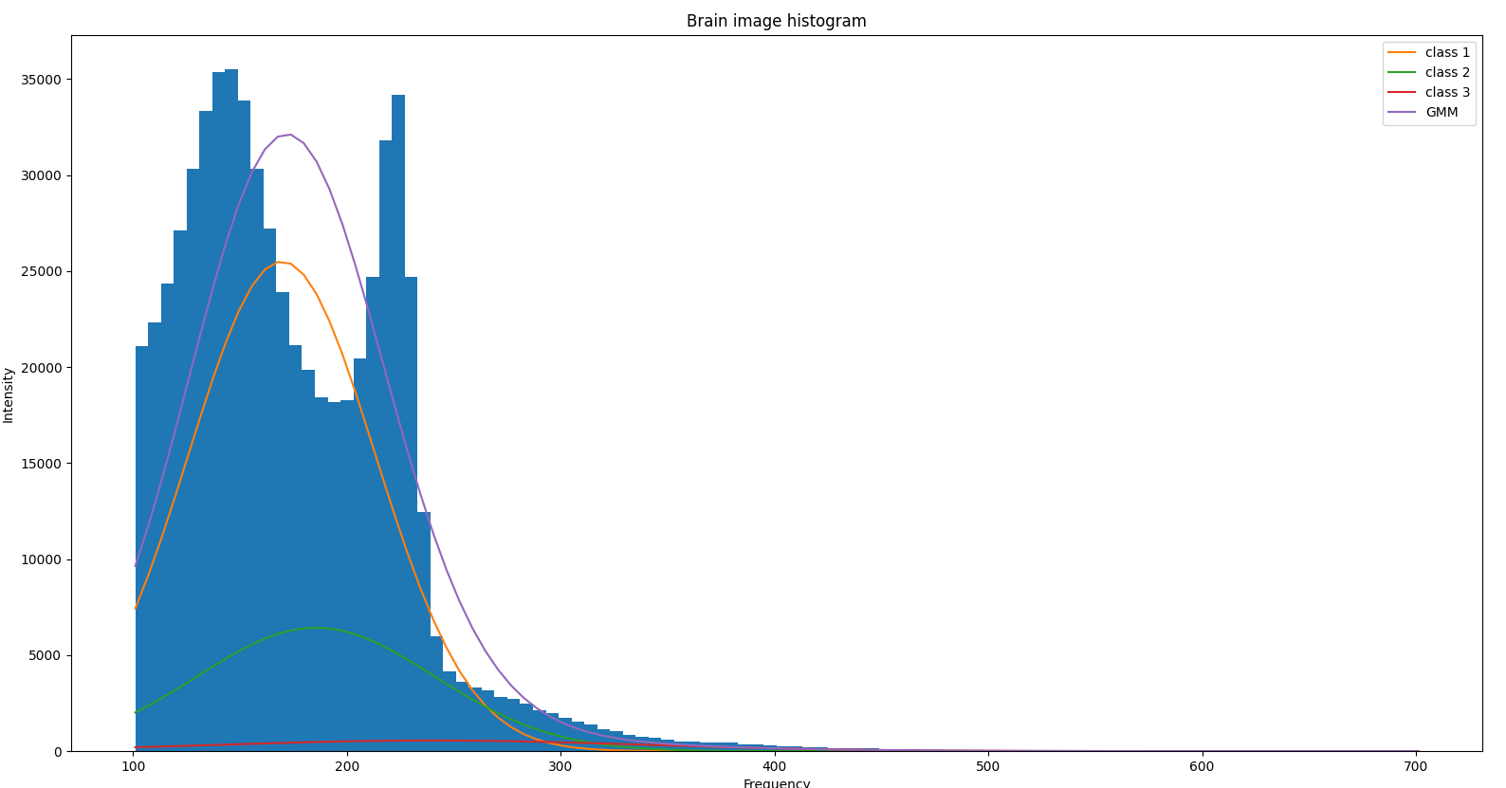
Iteration 10

Slide 6
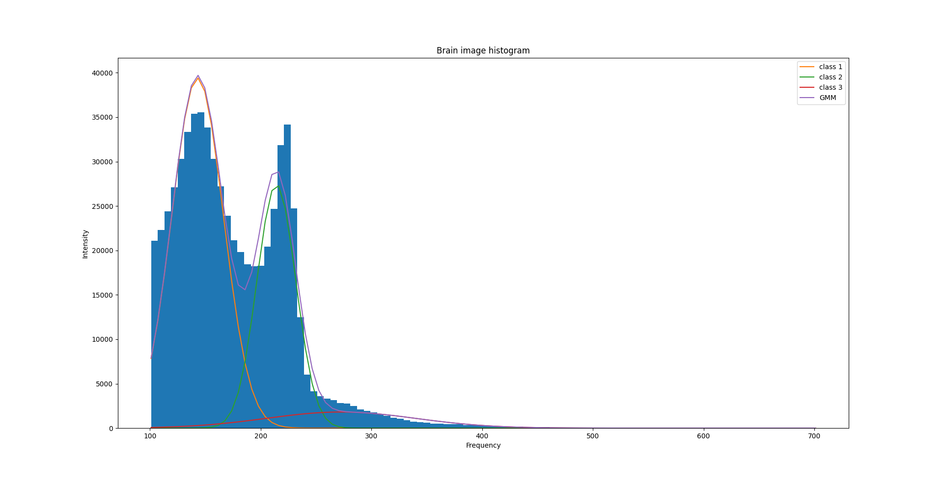
Iteration 50

Slide 7
Iteration 100

Slide 8
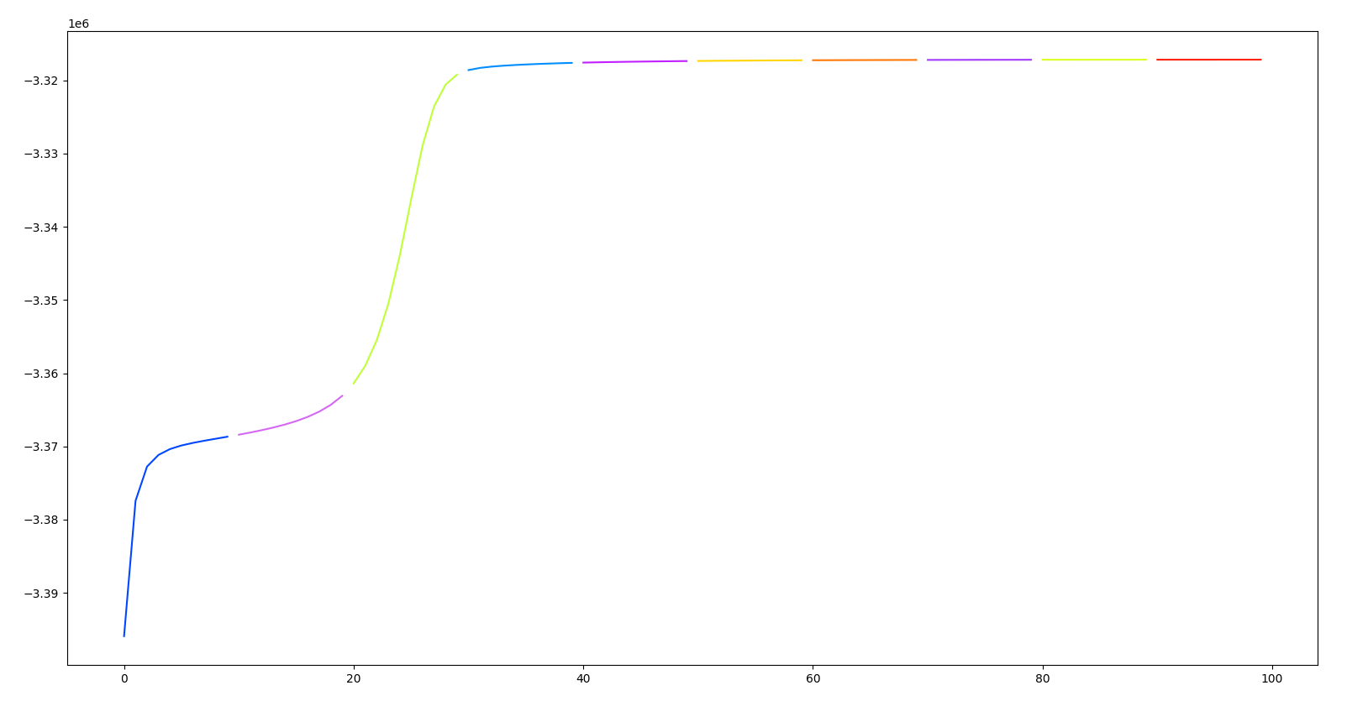
Log likelihood
iterations

Slide 9
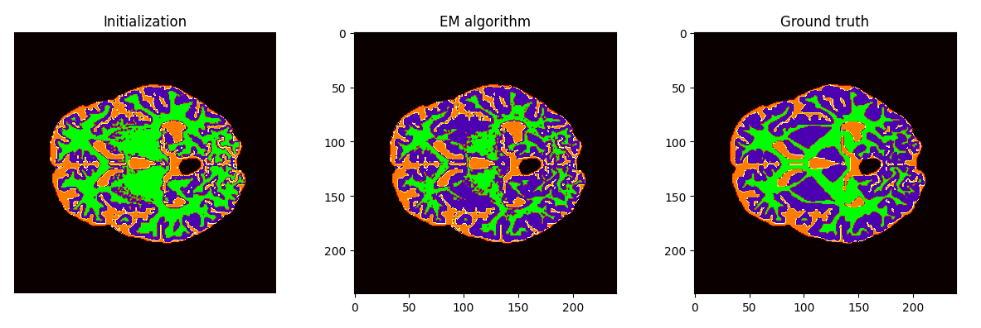
Test samples
From cv2.kmeans
$$argmax_{k}P\left(z_{i}=k | x_{i};θ_{t}\right)$$

Slide 10
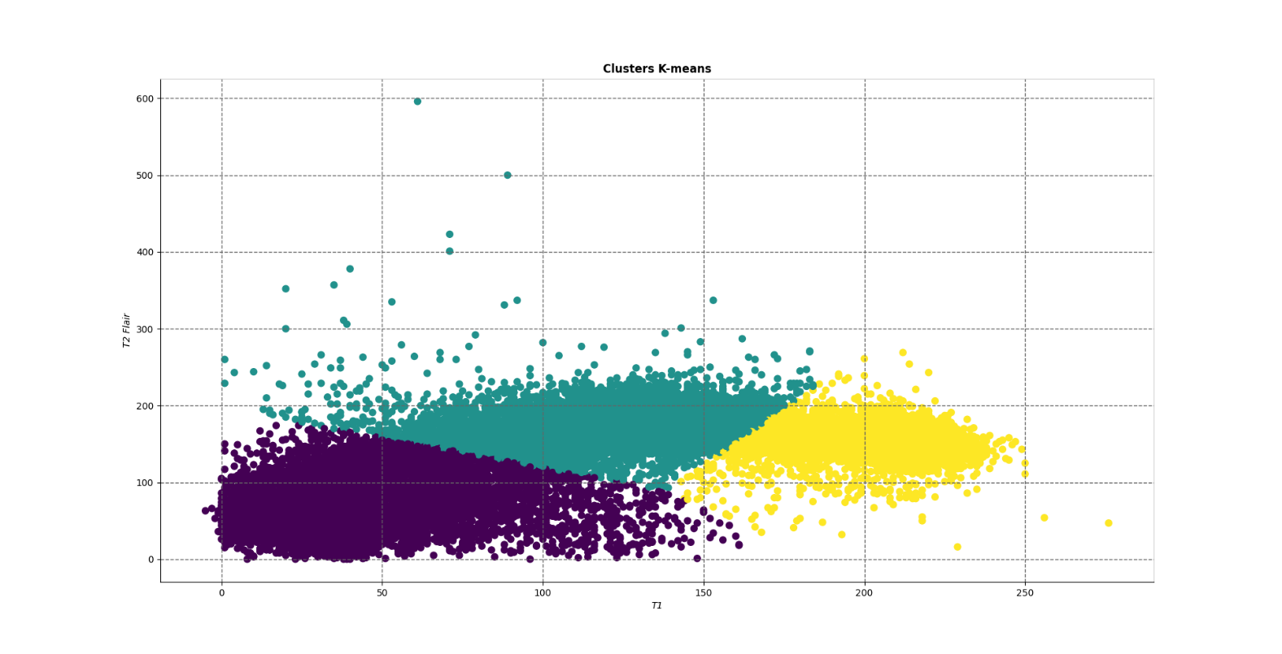
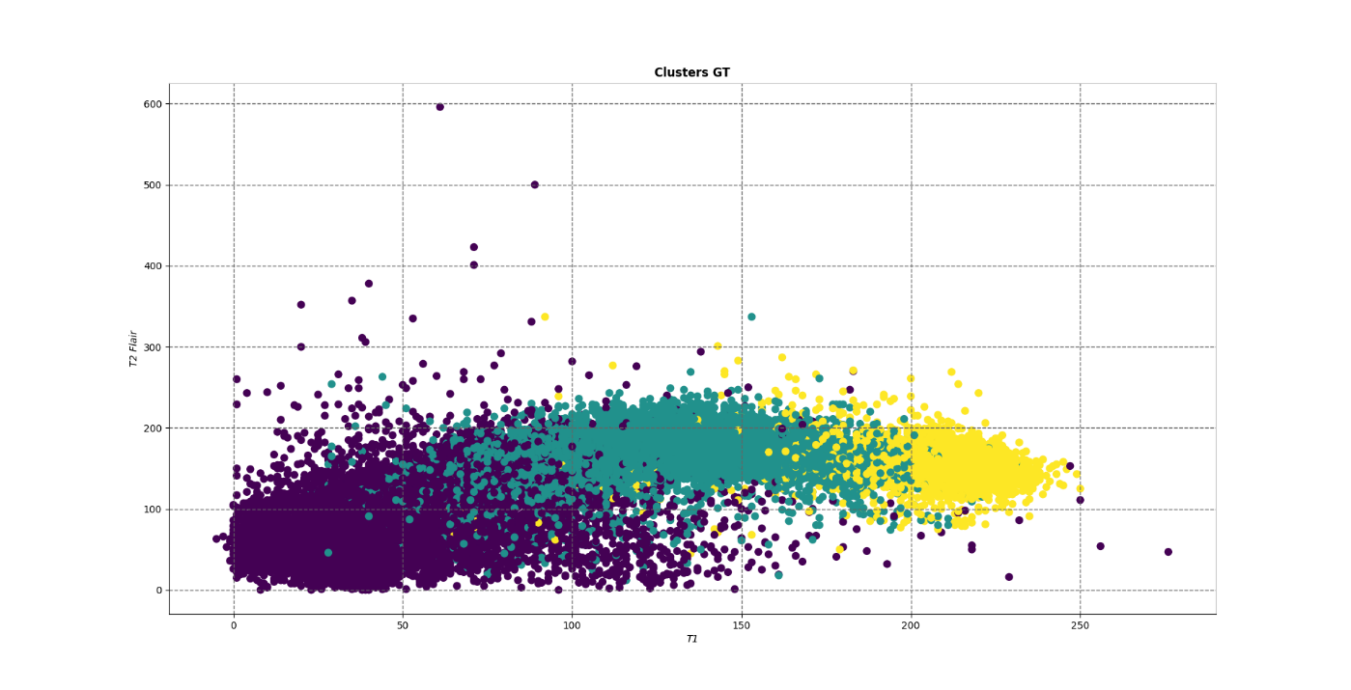
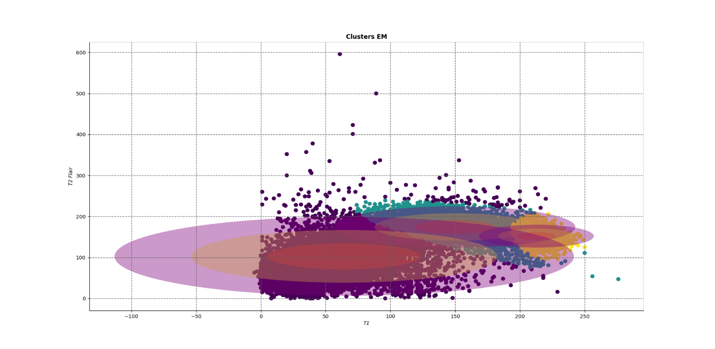

Slide 11
Segmentation prediction
$$argmax P(z_{i}=k|x_{i};θ^{T})$$
$μ_{k}:$ the mean vector of features
center of cluster
Recap the notation
$Σ_{k}:$ the covariance matrix of features
spread of cluster
$w_{k}:$ mixture weight
Proportion of data in cluster $k$
Segmentation result
 | Class 1 | Class 2 | Class 3
Sample 1 | 0.85/0.82 | 0.82/0.7 | 0.91/0.82
Sample 2 | 0.77/0.77 | 0.8/0.73 | 0.85/0.86
Sample 3 | 0.84/0.83 | 0.78/0.7 | 0.86/0.81
Sample 4 | 0.9/0.82 | 0.87/0.78 | 0.84/0.7
Sample 5 | 0.85/0.8 | 0.89/0.84 | 0.87/0.86
(Evaluation metric : IoU)

